Slide 1
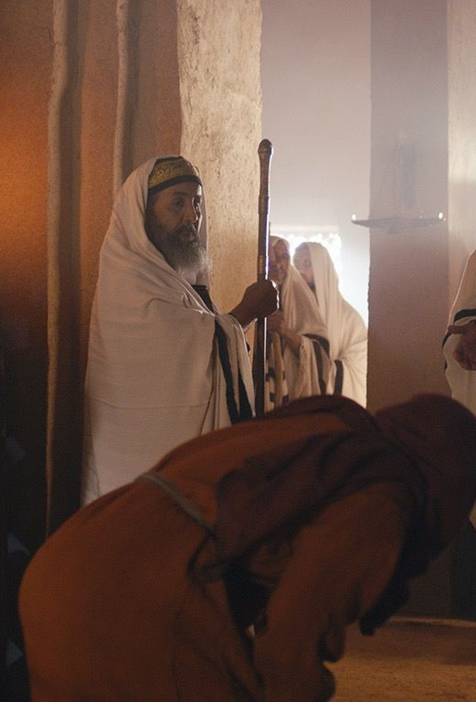
Woman of God, you are Loosed from Your Infirmity! Luke 13:11-12
“And behold, there was a woman who had a spirit of infirmity eighteen years and was bent over and could in no way raise herself up. But when Jesus saw her, He called her to Him and said to her, “Woman you are loosed from your infirmity”. (Luke 13: 11-12)

Slide 2
Introduction
Jesus was teaching in the synagogue on the sabbath.
He SAW a woman in the crowd who had a physical infirmity.
Her infirmity caused her to walk bent over for 18-years.
18 years of looking down at the ground.
18 years of not being able to look in the face of others.
18 years of being starred at by others when she went out in public.
18 years of constantly being talked about or ignored because of her infirmity.
We will discuss three points about this woman with an infirmity:
Jesus Prognosis of the Woman's Infirmity. (Luke 13:11)
Jesus Healing Process for the Woman’s Infirmity. (Luke 13: 12-13a)
The Woman’s Response to Jesus after He healed her Infirmity.

Slide 3
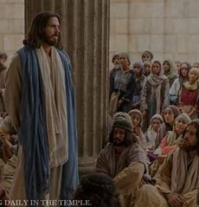
Jesus Prognosis of the Woman's Infirmity (Luke 13:11)
“…there was a woman who had a spirit of infirmity for 18 years and was bent over and could not raise herself up…”
The bible does not give any evidence of her previous life or the fact that she had previous knowledge of Jesus. But what it does tell us is that she was “a women who had a spirit of infirmity” and Jesus “saw her.” Not only did Jesus know the prognosis for her infirmity, but He also had the cure for her infirmity.
Out of all the people in the crowd, Jesus intentionally fixed his attention on this woman. Everybody else saw her and had pity on her, but they could not heal her. On the sabbath, (a day that no work was supposed to be done) this woman finds herself in the right place, at the right time, and in the presence of the right Person.
Application: We must know that God already know the prognosis of our infirmity and He has the cure.

Slide 4
Two Types of Infirmities
“Infirmity”- a physical or mental weakness; a quality or state of being weak; sickly.
Two kinds of infirmities: Physical and Spiritual
Physical Infirmity: I had surgery on my shoulder two months ago. After 5 weeks of physical therapy, my range of motion is at 70%. I’m unable to lift my arm above my head. I am left with a physical infirmity.
Spiritual Infirmity: As a young girl, I was sexually abused. I kept it secret from my husband for years because I was embarrassed and felt guilty about it. Because of the abuse, I felt unworthy. Because of my feeling of unworthiness and shame, I CHOSE to become promiscuous and disobedient in my young adult years. That was my spiritual infirmity.

Slide 5
Challenges of Spiritual Infirmities
When we refuse to recognize and acknowledge our infirmities, they become shackles that cause us to walk spiritually “bent” over. Examples of “spiritual “shackles:
Uncontrolled anger.
Feelings of unworthiness.
Irrational decisions.
Unforgiveness (self and/or others).
Promiscuous relationships.
Disrespecting parents/elders.
This Photo by Unknown Author is licensed under CC BY-NC-ND

Slide 6
Challenges of Spiritual Infirmities
The goal for spiritual infirmities is to keep you shackled and bound.
You were not created by God to be shackled and bound.
God’s desire is for you to be free from your shackles.
He wants you free from those things that keep you despondent and depressed.
You were created to glorify Him on earth.

Slide 7
Jesus Healing Process for the Woman’s Infirmity (Luke 13:12-13a)
Definition of “loosed” – set free; released, relieved from.
Out of all the folks in the crowd, the bible said Jesus saw her! It was NOT the woman who called out to Jesus for healing. But it was “Jesus who called her out in the midst of the crowd. Take note how He healed her:
Jesus pronounced that she was cured from her infirmity.
Then he laid hands on her and immediately she was healed.
She was no longer shackled by her infirmity.
She could walk straight up instead of bent over.
She no longer had to look at the ground while talking to folks.
She was set free and released from that which had her bound.

Slide 8
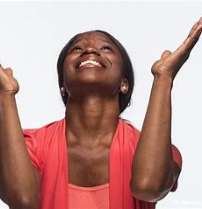
The Woman’s Response to Jesus after she was healed from her Infirmity. (Luke 13:13b)
“…. she glorified God.”
The most striking thing about her healing is that she didn’t have to ask for it. Jesus saw her need and met her need. He met her where she was.
My imagination is that she was so grateful for her healing; she couldn’t do nothing else but “glorify God.” She was excited about the new life before her.
Perhaps she had given up hope because her condition was degrading and embarrassing. But she didn’t allow her infirmity to stop her
The good news is it’s never too late to be healed from your infirmities!

Slide 9
God is Healing YOU from Your Infirmity
God will use songs, a sermon, or a praise dance to speak to you so that He can call you out for your healing.
God will stir up our spirit for the purpose of convicting us of our sins so that we no longer have to walk “bent over” from a spiritual infirmity.
And while He’s in the process of healing you, He will use you to be a testimony of His grace and mercy.
And just like this woman in the passage, we should give glory to God!
So, when you feel Him tugging at your heart, do not harden your heart. That tugging is the spirit of Christ calling you out. Beckoning you to humble yourself into His hands so that He can heal your spiritual infirmities.
The good news is it’s never too late to be healed from your infirmities!

Slide 10
Questions / Comments
Woman of God, you are Loosed from Your Infirmity! Luke 13:11-12

