Slide 1
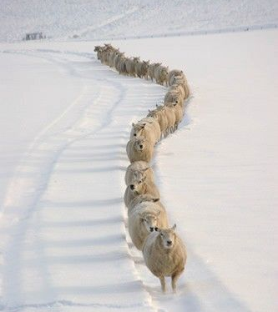
The Shepherd and the Sheep John 10:11 Sis. Sandra Kelley

Slide 2
What are the characteristics of “sheep”?
Easily frighten.
Friendly and social.
Characteristics of living like a family.
They exhibit a substantial flocking reaction (large and small groups). They feel safer when they are together in a group. They do not like being alone.
There is very little or no indication of dominance within their group.

Slide 3
“I am the good shepherd. The good shepherd sacrifices his life for the sheep.” (John 10:11 NLT)
In John 10 Jesus tells the parable about the Good Shepherd and His sheep.
Jesus identifies Himself as the “good shepherd.”
Sheep will recognize His voice.
He calls His sheep by name.
He leads His sheep.
His sheep follow Him.

Slide 4
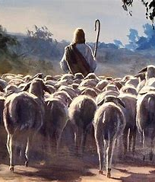
The Role of the Sheep:
Trust their shepherd
Follow the shepherd
Recognize their shepherd’s voice
Be obedient to the command of their shepherd

Slide 5
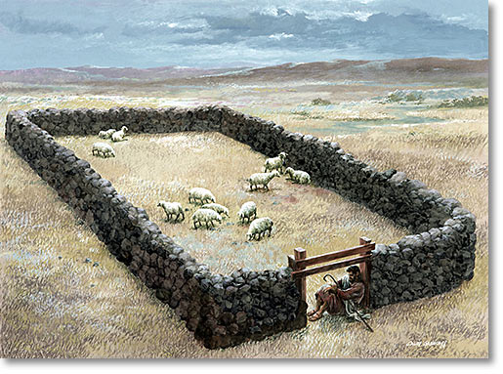
The Role of the Shepherd
Know his sheep
Lead his sheep
Protect his sheep
Sacrifice his life for his sheep

Slide 6
How do a shepherd “lead the sheep”?
A shepherd leads with a goal in mind that includes a destination, a direction.
The shepherd takes the sheep to a place of nourishment (green pastures), to a place they can be refreshed and quench their thirst (still waters), to a place where they could grow and mature (paths of righteousness).”
(Quote from Wikipedia)

Slide 7
To be led successfully, the sheep must first learn to follow successfully!
In order to follow successfully, the sheep must learn to trust his shepherd.
Trust is the foundation of every relationship. It takes years to build trust, but it only takes 1 minute to break it. One bad incident, one bad conversation; one bad decision can destroy trust.
The level of the relationship will determine the magnitude/commitment of their followship.
(John 10:3-5)
“…sheep recognize their shepherd’s voice”
“…they will not follow a stranger's voice….”
There are risk when we put our trust in man. But there are no risk when we place our trust in Jesus; who is the Shepherd of our life.

Slide 8
Jesus Knows Your Name John 10:14-16
“I am the Good Shepherd; I know MY own sheep, and they know me, just as my Father knows me and I know the Father. So, I sacrifice my life for the sheep. I have other sheep, too, that are not in this sheepfold. I must bring them also. They will listen to my voice, and there will be one flock “

Slide 9
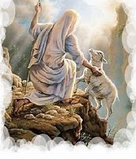
Matthew 18:12-14
“If a man have a hundred sheep and one of them wanders away, what will he do? Won’t he leave the ninety-nine others on the hills and go out to search for the one that is lost? And if he finds it, I tell you the truth, he will rejoice over it more than over the ninety-nine that didn’t wander away! In the same way, it is not my heavenly Father’s will that even one of these little ones should perish.”
Commit to saving the “one” that is lost!

Slide 10
Personal Reflection on the Shepherd:
Jesus knows our every concern, every heartache, every mistake, and every disappointment.
Jesus already have the solution for our problem before we asked.
Jesus wants us to allow Him to lead us.
He beckons us to thrive in our relationship with Him.
He wants us to grow in our knowledge of Him by spending quality time in prayer, praise and worship.

Slide 11
Personal Self-Reflection:
When we pursue a more intimate knowledge of Him as our Shepherd, we will discover that:
He already have the solution for our problem before we ask.
Our perception about life and issues will change.
Nobody can validate us the way that He does.
Our value in His eyes is unmeasurable.
Our trust in Him is much bigger than our problems.
Jesus is beckoning us to thrive in our relationship with Him.
He wants us to grow in our knowledge of Him by spending quality time in prayer, praise and worship.

Slide 12
Discussion Questions:
Discuss the responsibilities of a good shepherd that was noted in this lesson.
Discuss the responsibilities of the sheep.
In order to have successful followship; what is the key element required in a relationship that was mentioned in this lesson?
IF you find yourself following the wrong voice, what can you do to get back on track?
Discuss ways that you can allow Jesus to be the shepherd of your life?

